Slide 1
Radio Frequency Astronomy
Matthew A. Morgan

Slide 2
Outline
The National Radio Astronomy Observatory
Astronomical Interferometry
Components and Instrumentation
Technical Focus: Reflectionless Filters

Slide 3
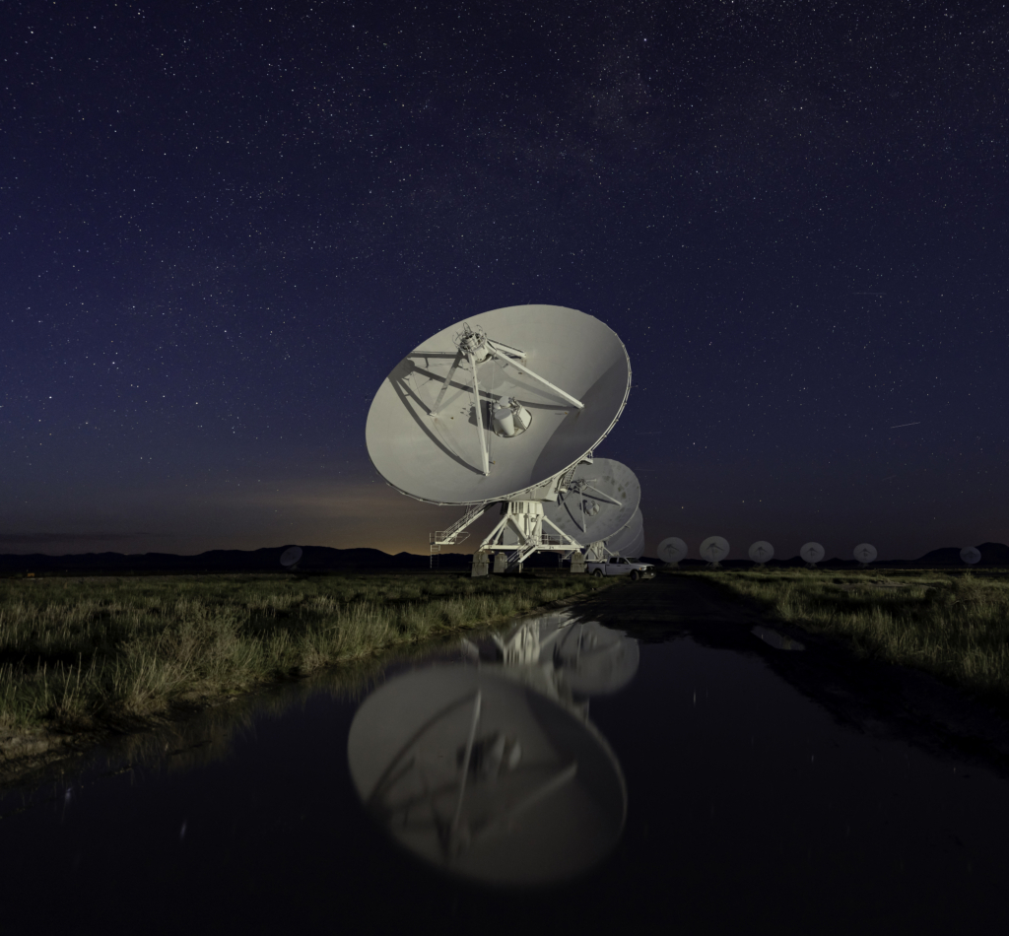
The National Radio Astronomy Observatory

Slide 4



The National Radio Astronomy Observatory
Builds and operates state-of-the-art radio telescope facilities for use by the international scientific community.
Is funded by the National Science Foundation.
Is operated by cooperative agreement with Associated Universities, Inc.

Slide 5
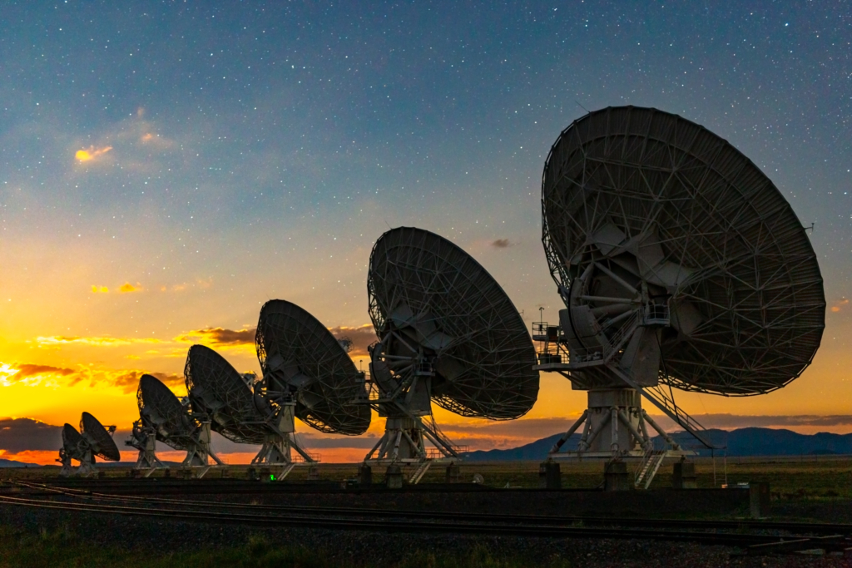
The Jansky Very Large Array (VLA)
27 antennas
25m diameter
1.0 GHz to 50 GHz
Notes:
Number of antennas 28 (27 active and 1 spare)
Dish size 25 meters
Weight 230 tons
Latitude 34°04'43.497" North
Longitude 107°37'03.819" West
Dish Surface Aluminum panels accurate up to .5 mm
BUS Steel
Frequencies From 1.0 GHz to 50 GHz
Resolution 0.2 arcseconds to 0.04 arcseconds
Reconfigurable Array North arm is 11 miles long, two other arms are 13 miles long
A configuration size 22.62 miles across
B configuration size 7.08 miles across
C configuration size 2.11 miles across
D configuration size 0.64 miles across

Slide 6
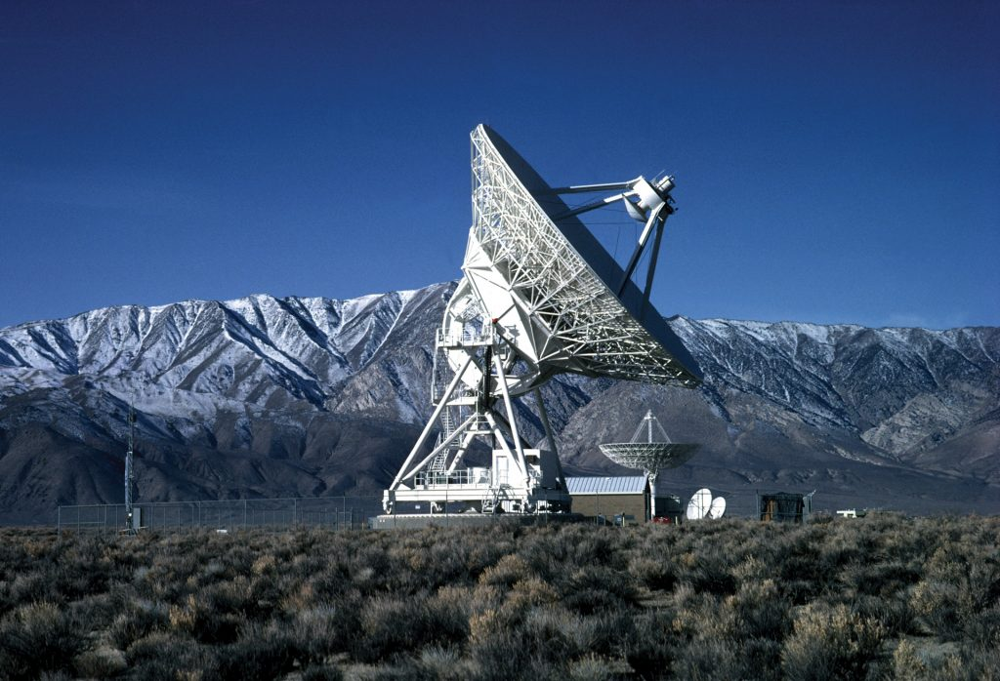

The Very Long Baseline Array (VLBA)
10 antennas
25m diameter
300 MHz to 96 GHz
8611 km maximum baseline
Notes:
Number of Dishes 10
Dish Sizes 25 meters (82 feet)
Antenna Weight ~ 218 tons
Total Collecting Area 19,635 square meters
Receiver Frequencies 0.3 GHz – 96 GHz (90 cm – 3 mm)
Resolution 0.17 – 22 milliarcseconds
Array Size Maximum baseline of 8,611 km (5,350 mi)

Slide 7
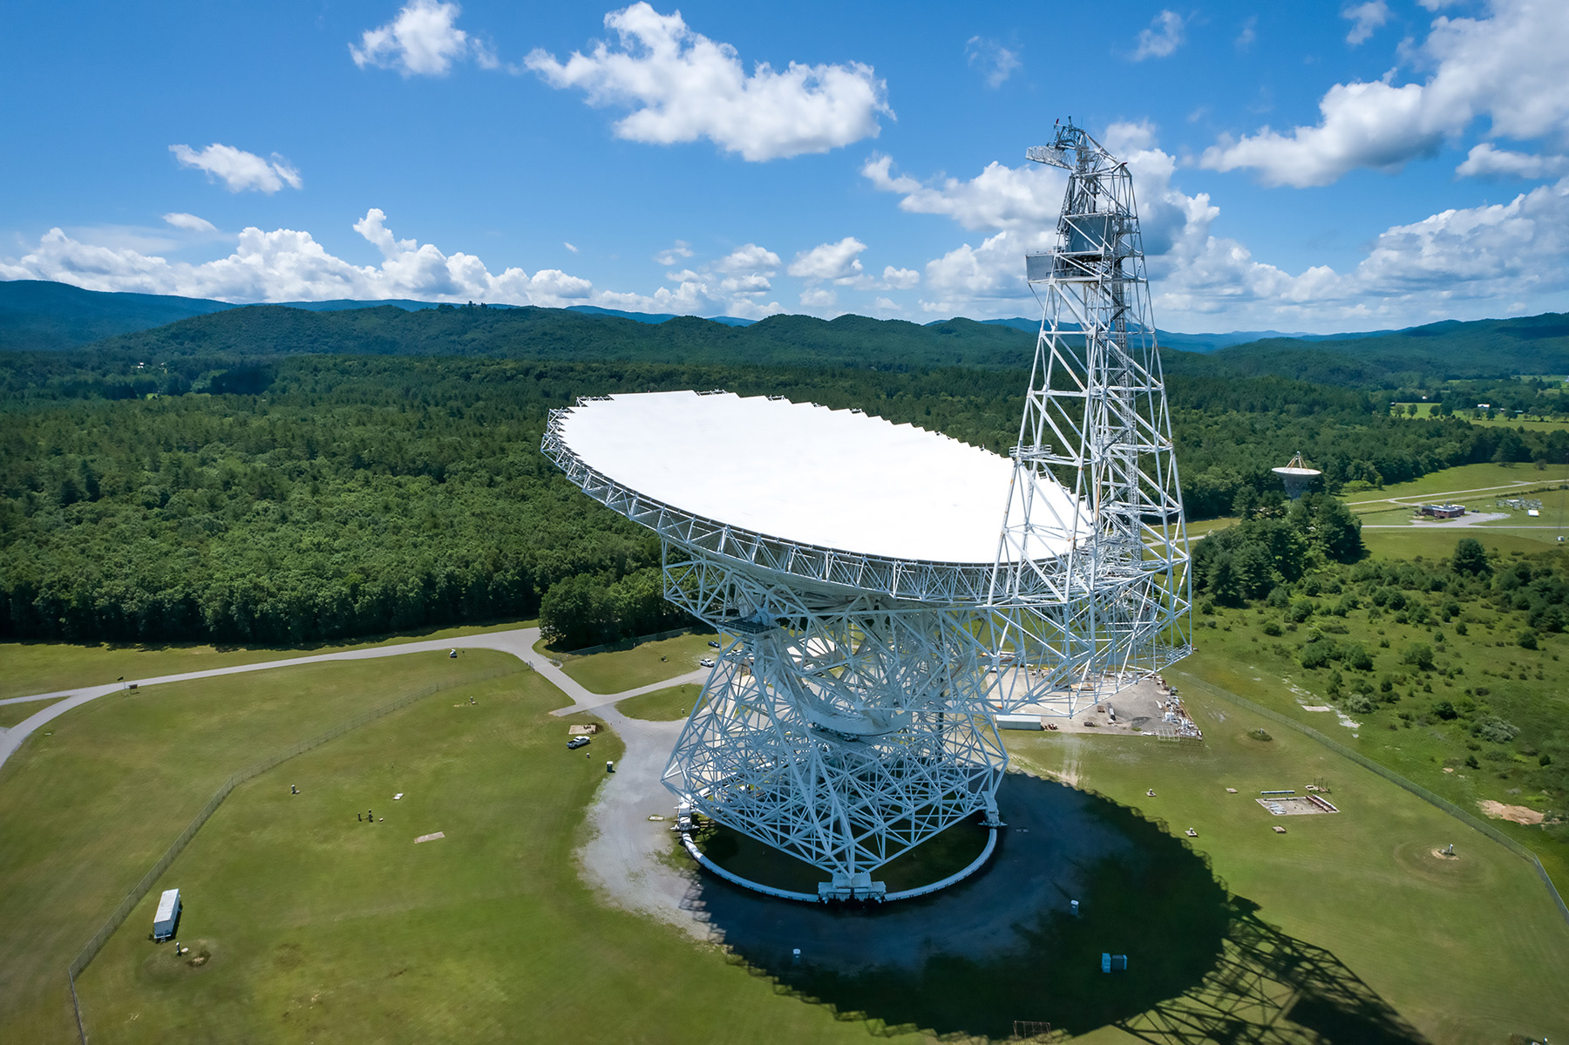
The Robert C. Byrd Green Bank Telescope (GBT)
1 antenna
100m diameter (2.3 acres)
100 MHz to 116 GHz
Notes:
The surface of the GBT is perfectly smooth to a noise level of 260 microns (5 human hairs)
The pointing accuracy of the GBT is 2 arc seconds, able to resolve a quarter at 3 miles
The GBT weighs almost 17 million pounds and stands over 485 feet above ground level
The GBT’s collecting area is 2.34 acres and its diameter is 300 feet

Slide 8
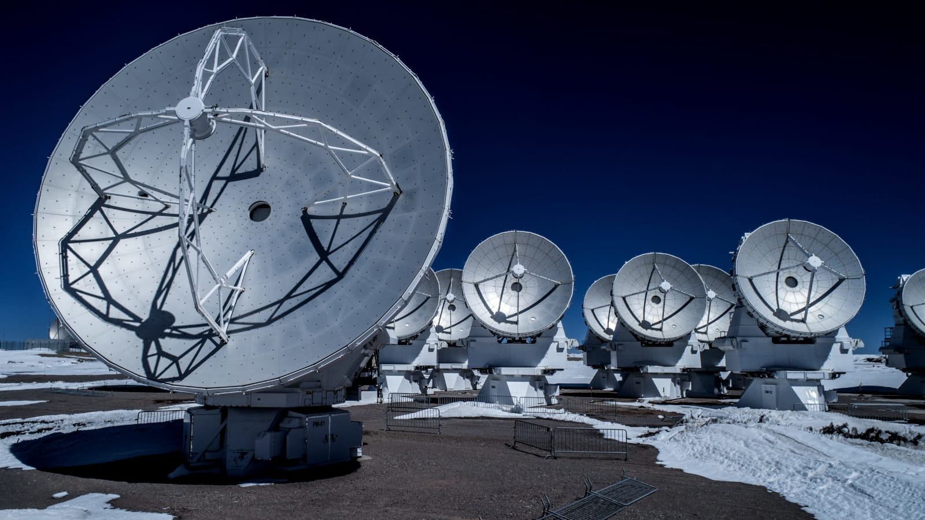
The Atacama Large Millimeter Array (ALMA)
66 antennas
7m and 12m diameter
35 GHz to 950 GHz
25 μm surface accuracy
16,500 ft. altitude
Notes:
Number of antennas 66
Dish sizes Fifty-four 12 meter and twelve 7 meter
Antenna weight ~100 tons
Total collecting area of array 71,000 square feet or 6600 square meters
Number of antenna pads 192
Receiver frequencies From 35 GHz to 950 GHz
Resolution 12.5 arcseconds to 0.009 arcseconds
Reconfigurable array Minimum of 160 m, maximum of 16 km
Partners United States, Chile, Japan, Europe, Taiwan and Canada
Average annual rainfall 2.3in or 58mm
Average daily temperature at site 34°F or 1.1°C
Elevation 16,500 ft or 5000 m

Slide 9
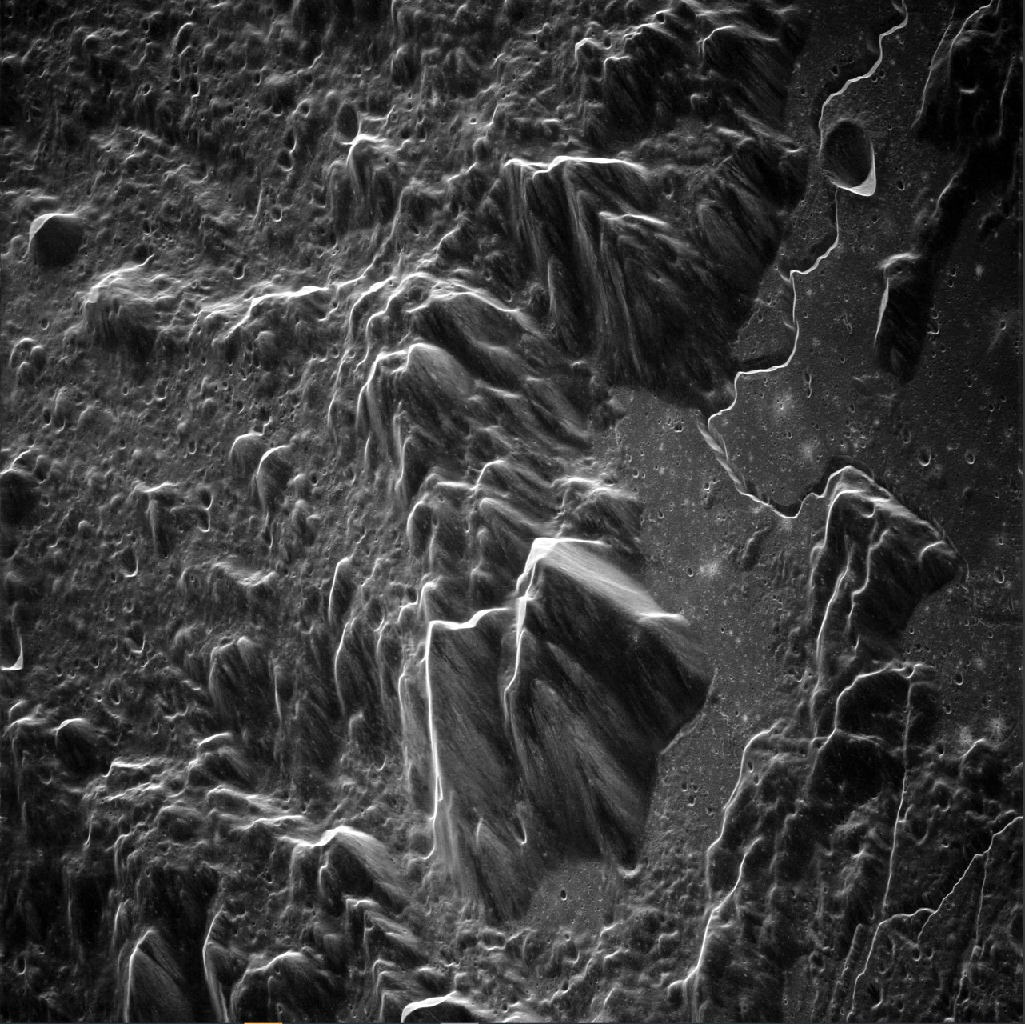
Radar with the GBT and VLBA
Initial proof-of-concept tests
700W, 13.9 GHz transmitter on GBT
Return signal received by VLBA.
Apollo 15 landing site shown.
~1.25m resolution.
The finest-resolution images ever taken of the moon from the (Earth) ground.
image credit: Raytheon
Notes:
A recent article in the Microwave Journal reported on radar experiments done using the GBT and VLBA that successfully produced high resolution images of the Moon, and detected a Near-Earth Asteroid making a close flyby of Earth, more than 5 times farther away than the Moon – using less power than a microwave oven. In these tests, as a proof of concept, the GBT transmitted a 650-watt radar signal at 13.9 GHz that was received by VLBA antennas, producing radar images of the Moon’s surface with unprecedented detail.

Slide 10
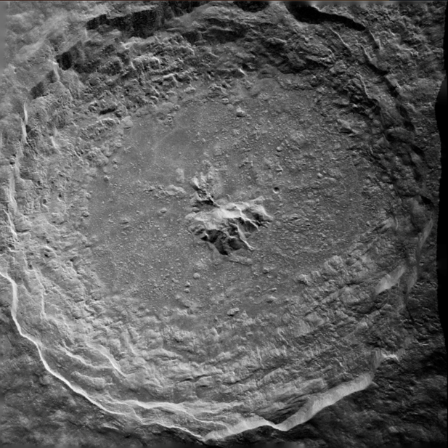
Radar with the GBT and VLBA
Tycho crater shown at 9m resolution.
Planned upgrade: 500 kW
Uses:
Planetary defense (NEOs)
Space situational awareness
Geology and planetary science (asteroids, comets, planets, and moons)
image credit: Raytheon
Notes:
Demonstrated compelling radar results using a pilot system with potential for:
Meter-scale imaging of the Moon from the ground
Geology and dynamics
Detecting, tracking, and characterizing space debris in cislunar space
Safety and security
Detecting, tracking, and characterizing NEOs for planetary defense
Impact hazard assessment and mitigation planning
Studying solid bodies across the Solar System for planetary science
Physical and dynamical characterization

Slide 11
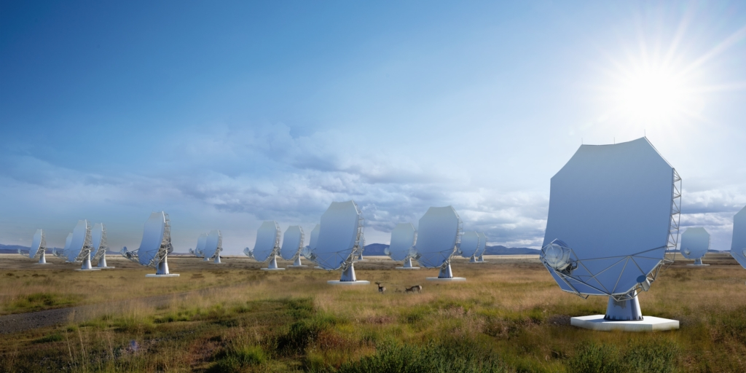
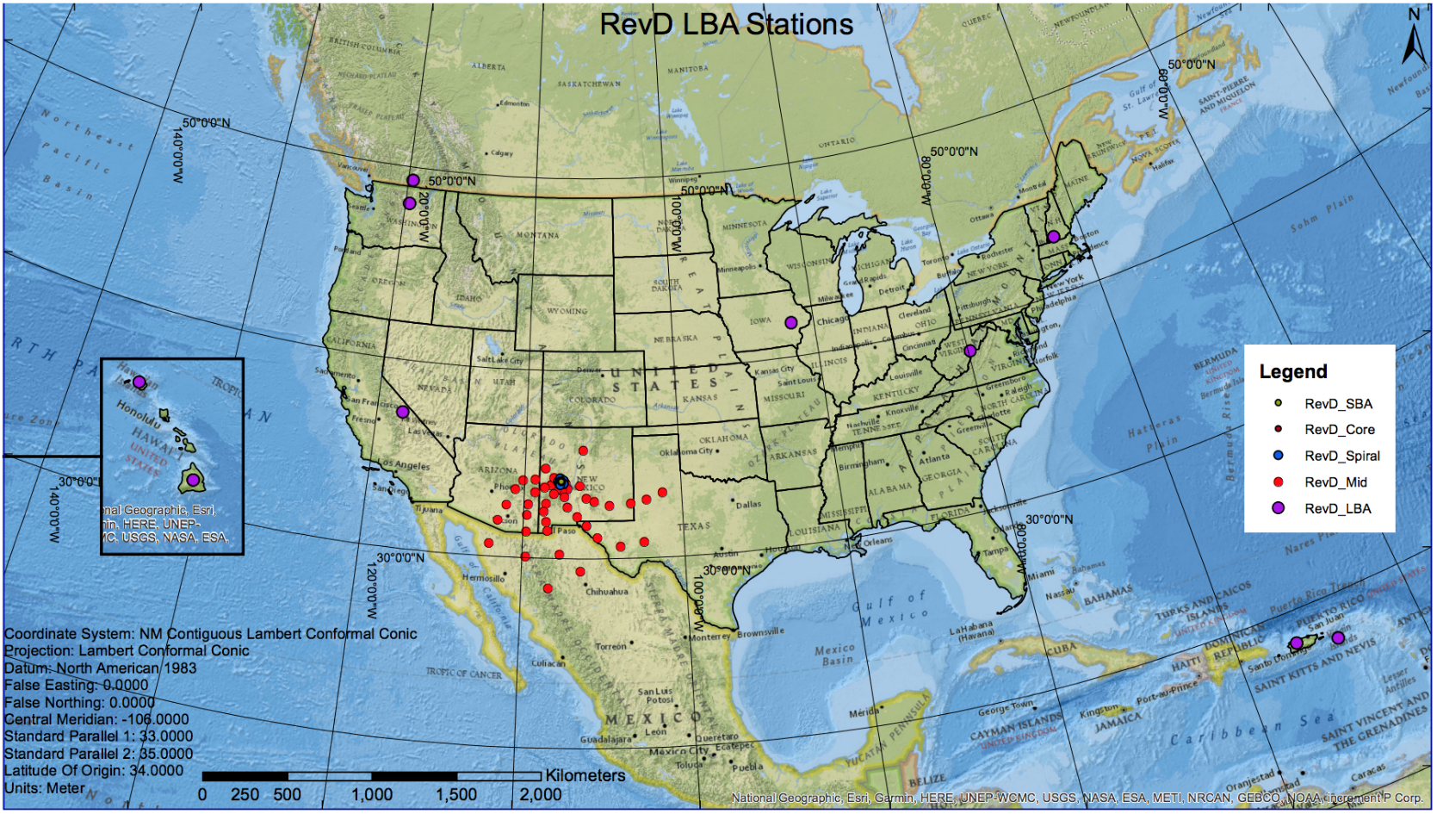
Next-Generation Very Large Array (ngVLA)
263 antennas
6m and 18m diameter
1.2 GHz – 116 GHz
8860 km maximum baseline

Slide 12

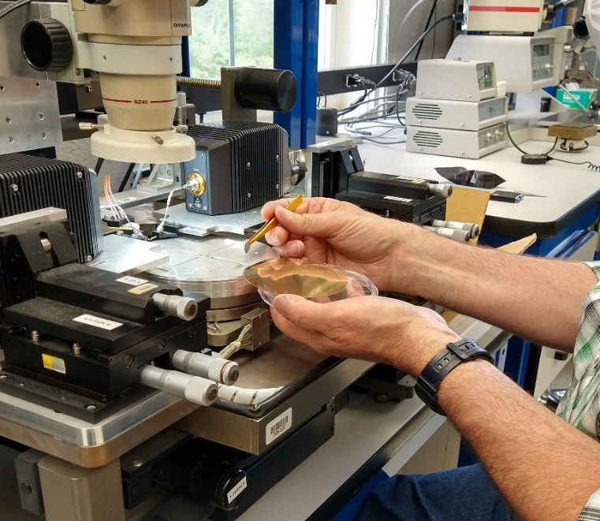
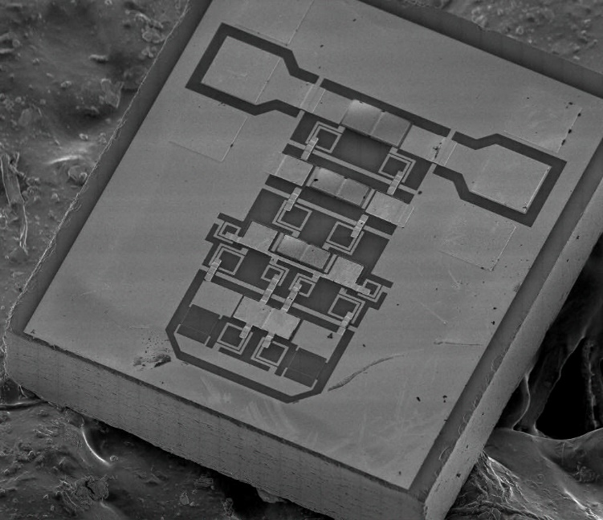
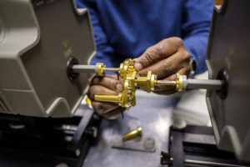
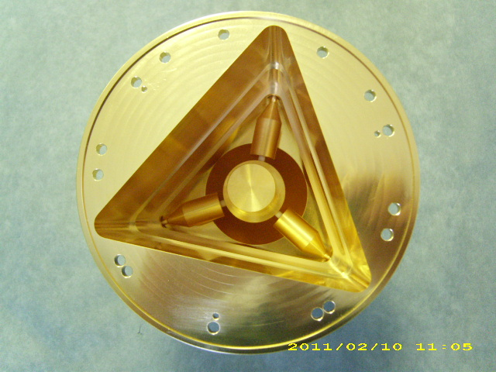
The Central Development Laboratory (CDL)
Notes:
Approx. 50 engineers, scientists, machinists, and technicians
38,000 sq. ft. lab and office space

Slide 13
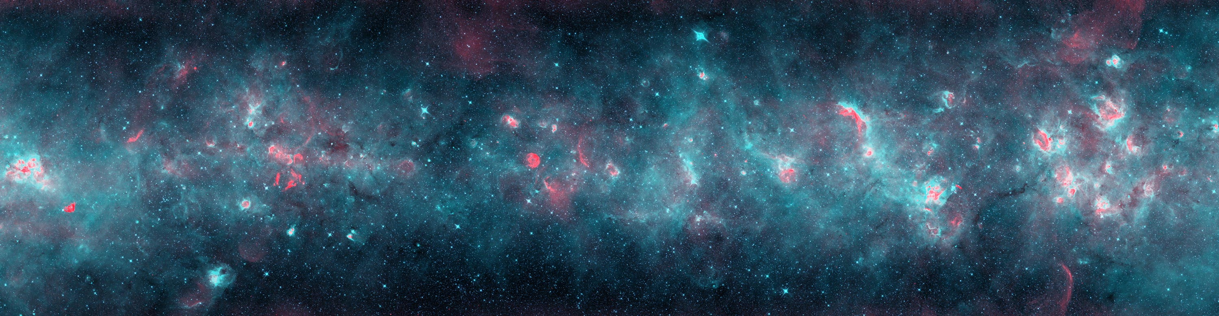
Astronomical Interferometry

Slide 14
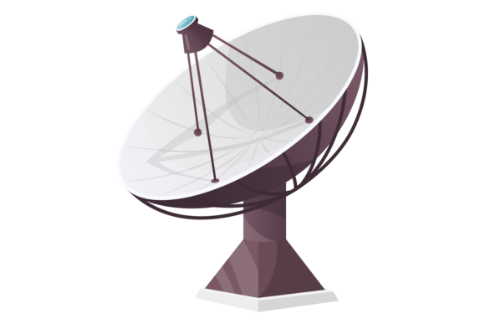
Wavefront Synchronization
Precision timing
femtoseconds of delay
Hydrogen masers
Round-trip phase monitoring corrected by fiber-stretchers or numerical calibration
Mathematical solution determines telescope positions to sub-wavelength accuracy.
D sin θ
θ
θ
D

Slide 15
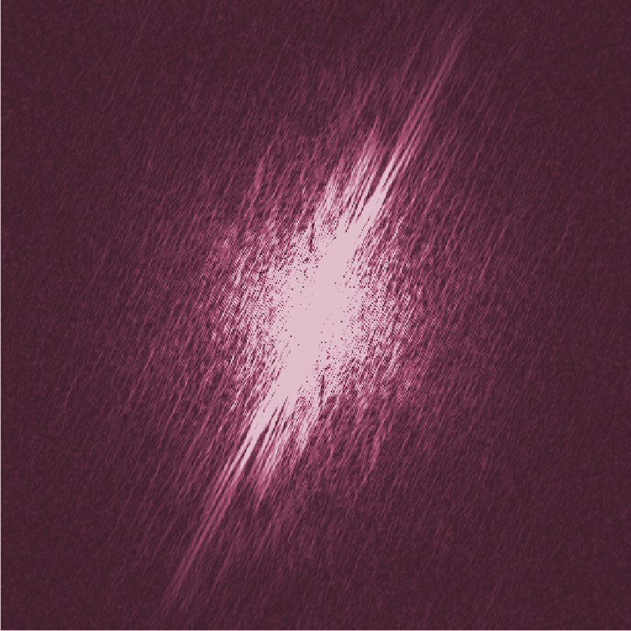
Interferometry and Fourier Transforms
Fourier Plane
cross-correlations...
...and auto-correlation.

Slide 16
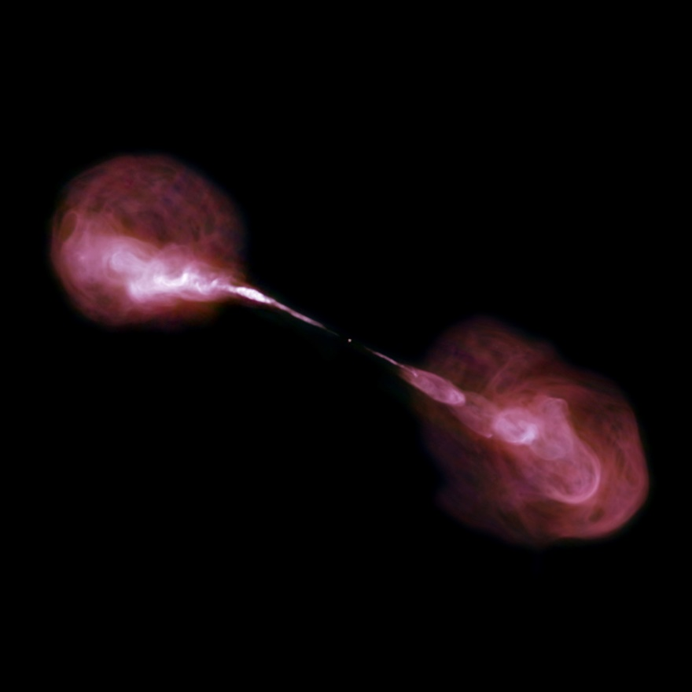
Interferometry and Fourier Transforms
Earth rotation
Fourier Plane
Fourier Transform
(Hercules A)

Slide 17
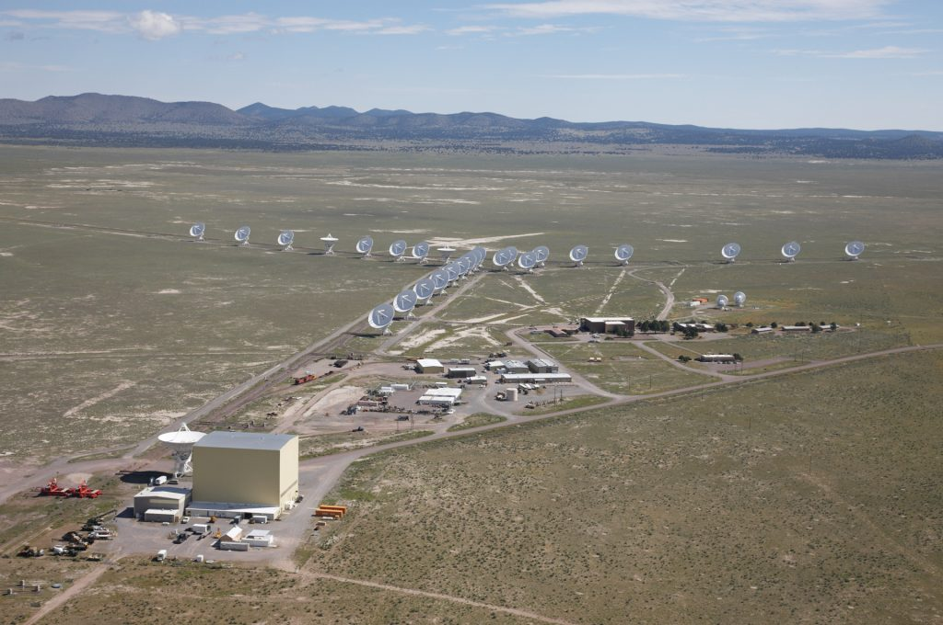
Resolution and Sensitivity
An interferometric array has the same resolution as a single dish with diameter equal to the maximum baseline.
Sensitivity, on the other hand, is determined by collecting area.

Slide 18
Geodesy
The very precise determination of telescope positions from interferometric calibration additionally supports geodetic measurements
Earth Orientation Parameters (EOP)
Celestial Reference Frame (CRF)
Terrestrial Reference Frame (TRF)
Movements of the Earth’s crust
D sin θ
θ
θ
D

Slide 19
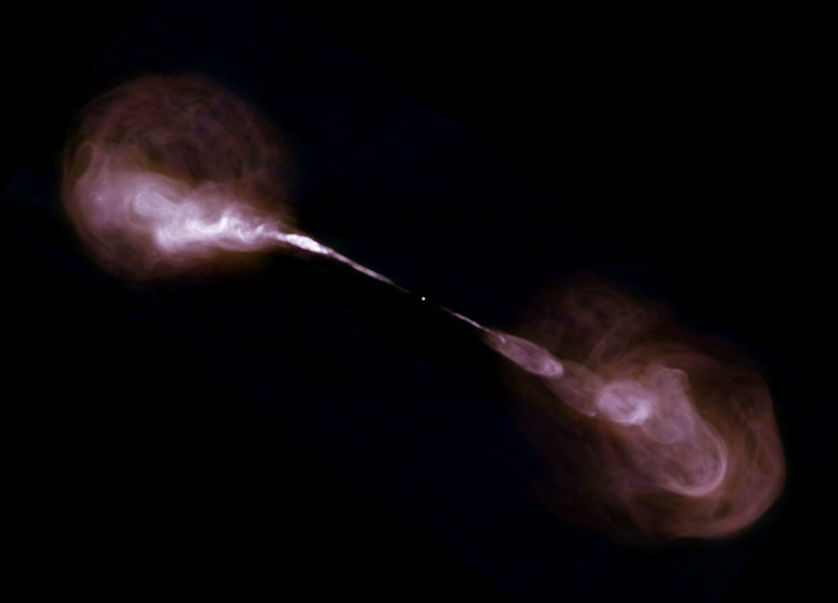
Components and Instrumentation

Slide 20
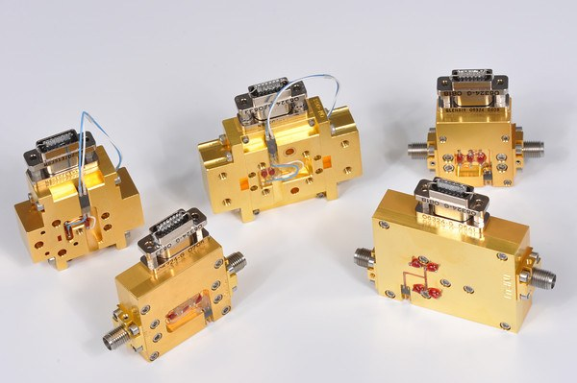
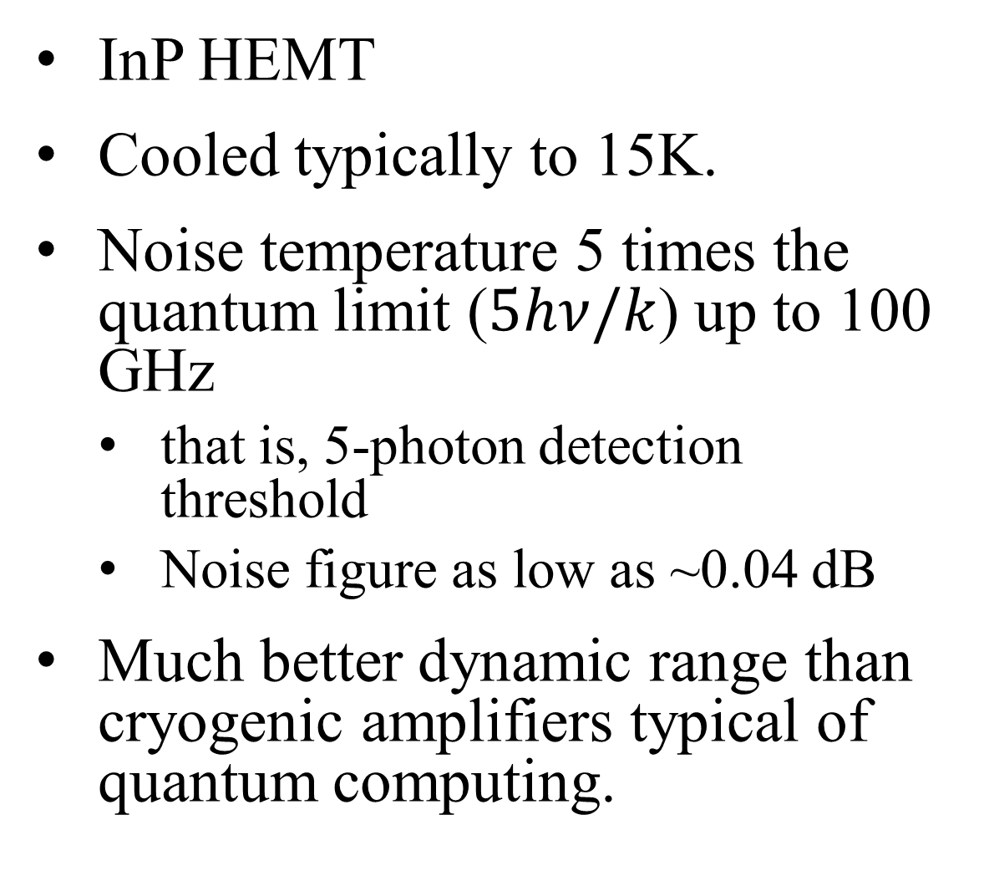
Cryogenic Low-Noise Amplifiers
InP HEMT
Cooled typically to 15K.
Noise temperature 5 times the quantum limit ($5hν/k$) up to 100 GHz
that is, 5-photon detection threshold
Noise figure as low as ~0.04 dB
Much better dynamic range than cryogenic amplifiers typical of quantum computing.
Notes:
Best result is about 2-3K at <10 GHz (about 0.04 dB NF)
P1dB on the order of -15 dBm

Slide 21
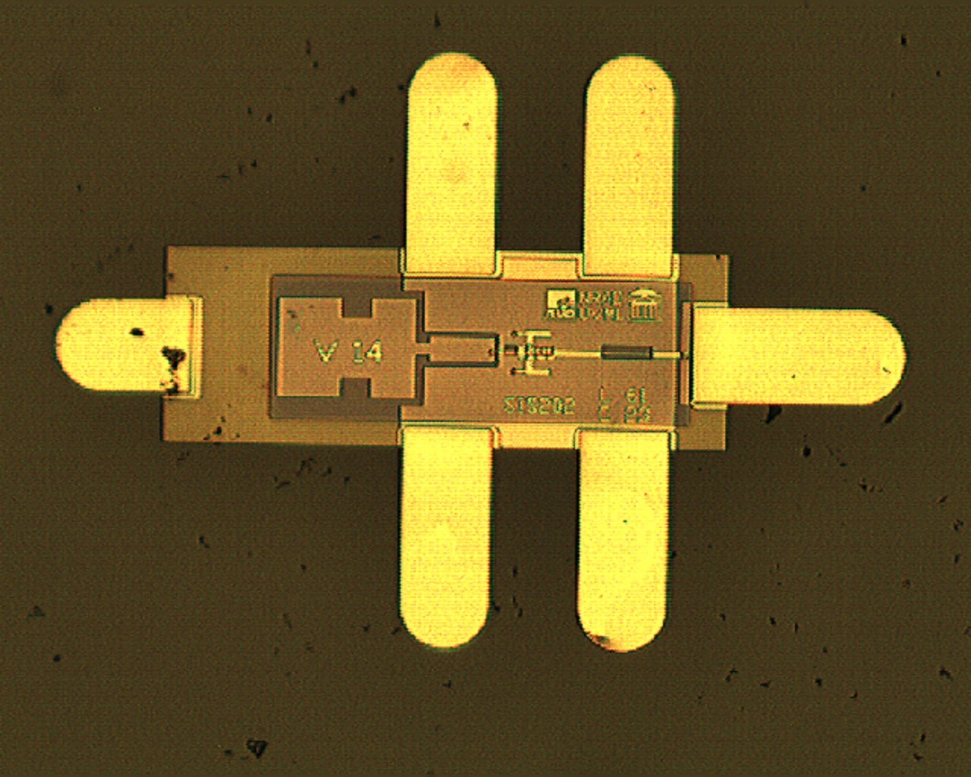
Superconducting Mixers
Based on superconducting-insulating-superconducting (SIS) tunnel junction.
Nb/Al-AlN/Nb
Approx. 1 μm junction size.
Near quantum-limited performance, 100 GHz to 1 THz.
Balanced and sideband-separating configurations.
Notes:
Mixer is near quantum-limited (maybe 1.5 hv/k), but receiver noise also must include IF cryo amplifier
Crossover point for LNA-first and SIS-first receivers is about 100 GHz.

Slide 22
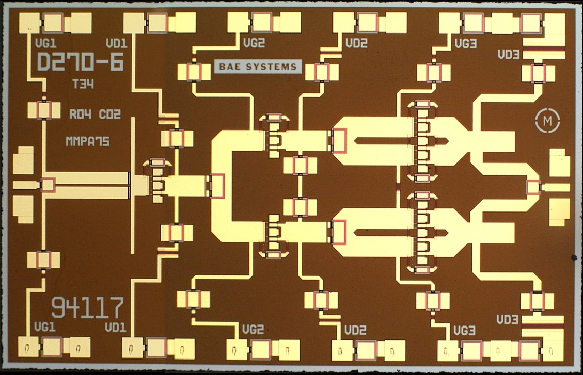
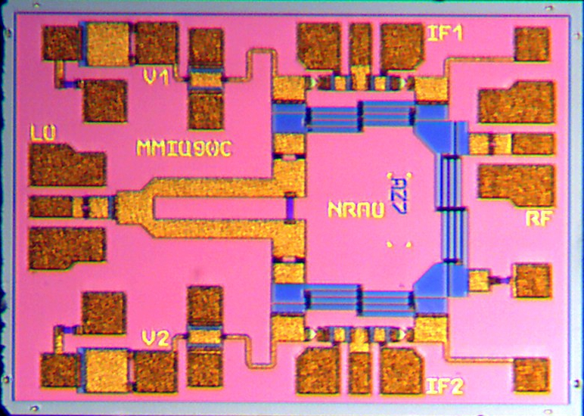
Custom mm-wave MMICs
Various Functions:
Power amplifiers
Schottky-diode mixers
Varactor multipliers
Switches
Variable Attenuators
Broadband
Typically 50-100 GHz

Slide 23
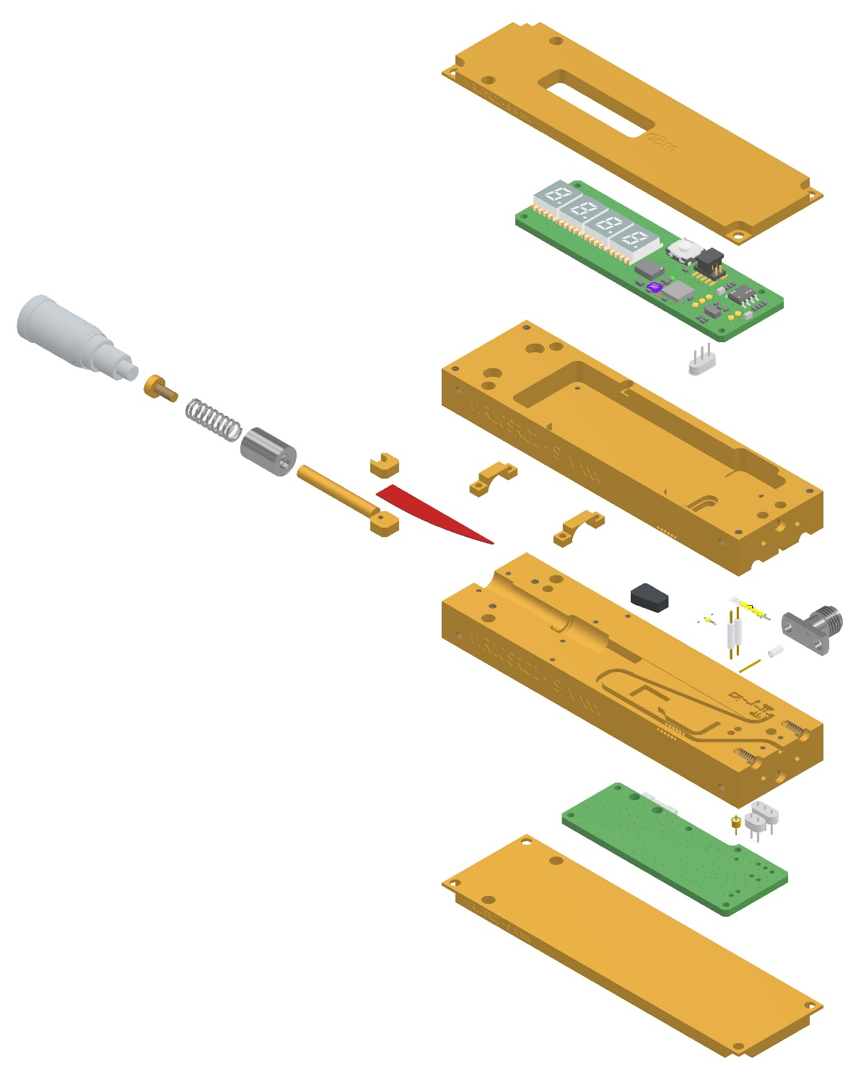
Integrated Modules
Analog-Digital-Photonic subassemblies.
cm-wave to mm-wave
Wideband, warm receiver chains
RF-baseband conversion
Analog-digital conversion
Copper-fiber conversion
Filtering
Power leveling
Compact laboratory signal sources and testers

Slide 24
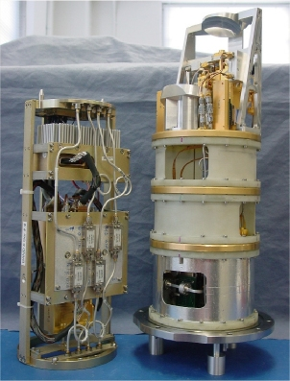
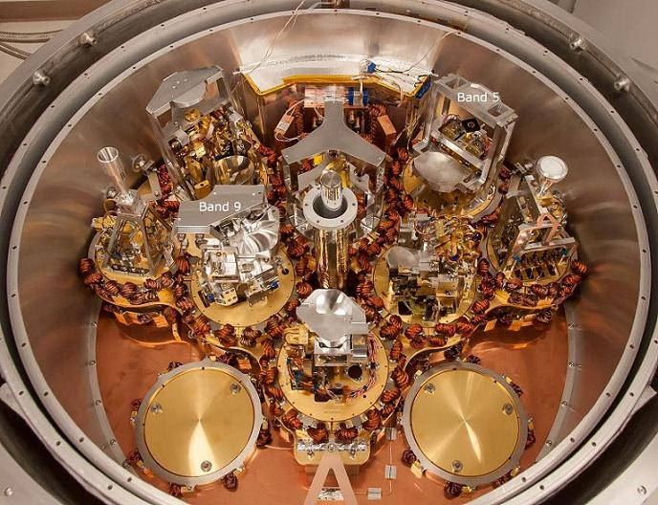
Full Receiver Assemblies
ALMA Band 6 (211–275 GHz)
Warm and Cold Cartridges
Full 10-Band ALMA Cryostat

Slide 25
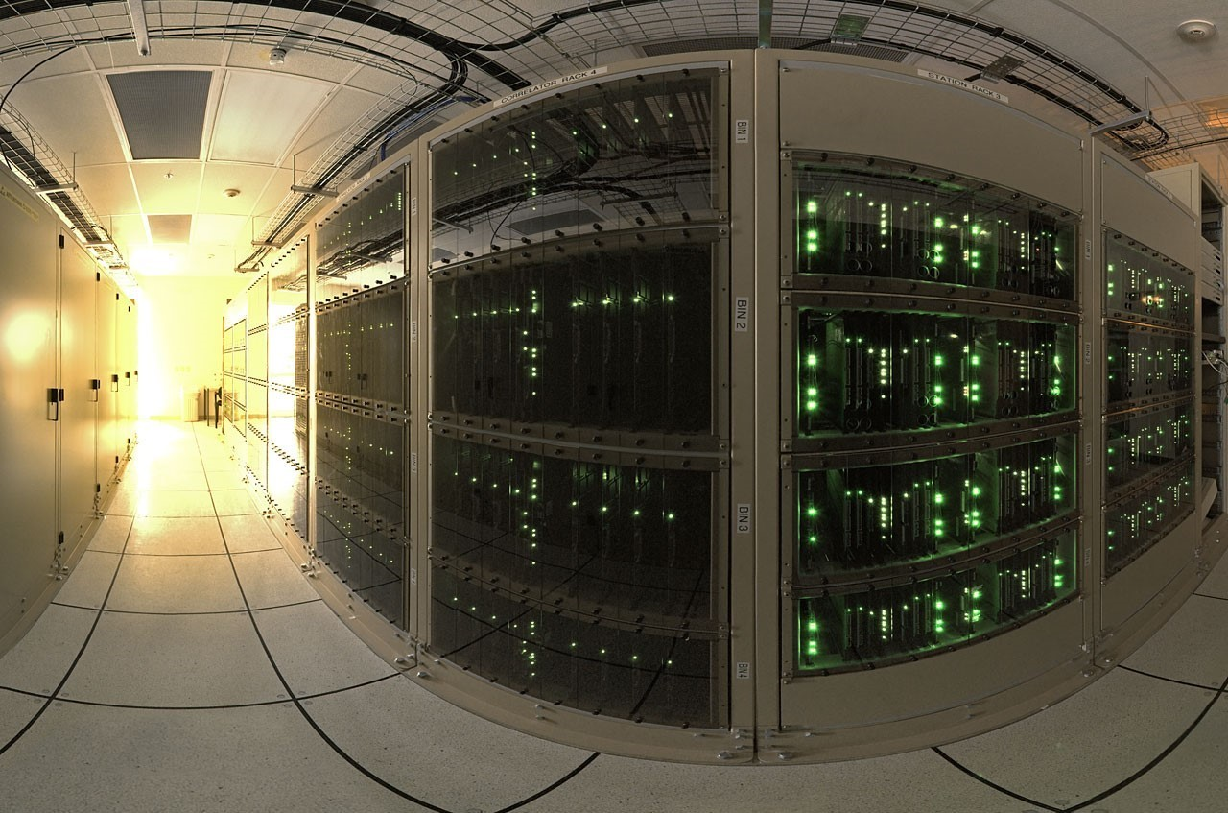
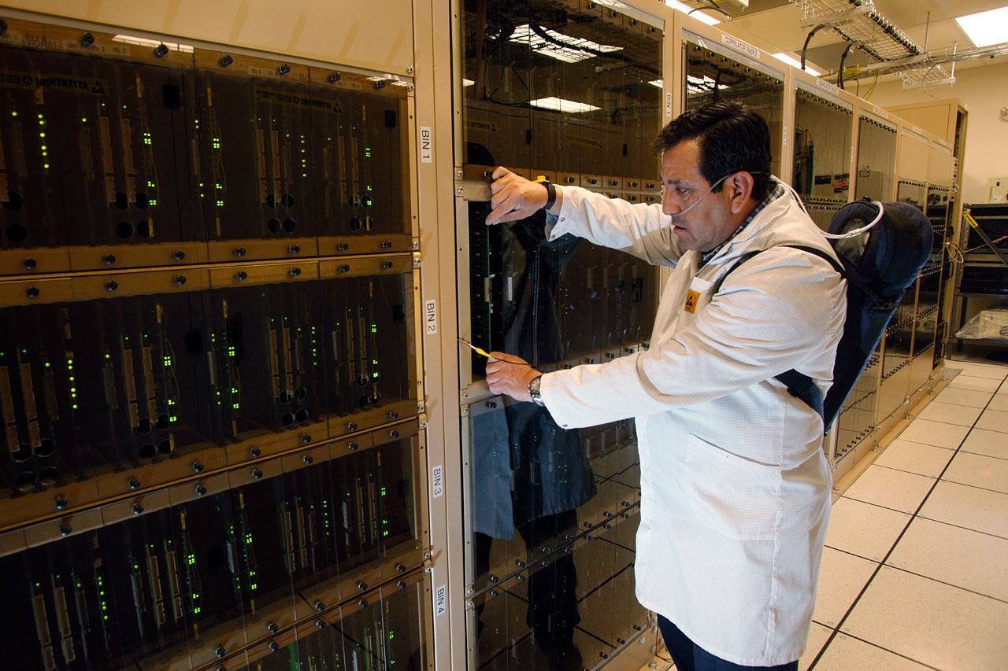
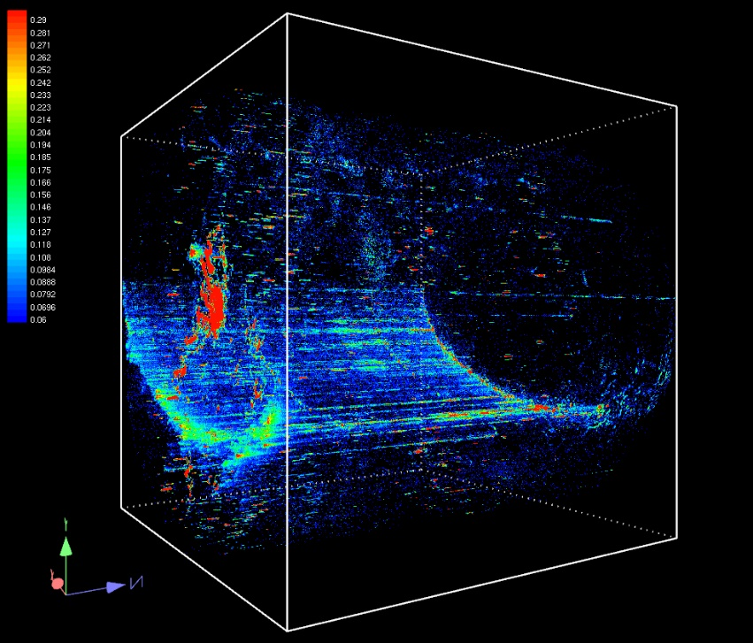
Digital Correlators
The correlator converts data from multiple telescopes into images.
Actually, hyperspectral image cubes
The ALMA Correlator is one of the most powerful supercomputers in the world:
134 million processors
17 peta-ops
Notes:
1 The supercomputer operating at the highest altitude in the world
200 Kilometers of fiber opticconnect ALMA to the city of Calama, where it connects to Antofagasta, Santiago and the rest of the world
17 PetaOperations (17 trillion operations per second), equivalent to billions of dollars in personal computers to make the necessary calculations. This is the fastest computer ever used in an astronomical site
134 Million processors
2912 Printed circuits
5200 Cables of interface
20 Million welding points
2016 Antenna pairings which make the correlator capable of simultaneously running the interferometry
1 Second every three million years is the possible delay in the atomic watch (hydrogen maser) that allows ALMA to observe in synchronization with other telescopes

Slide 26
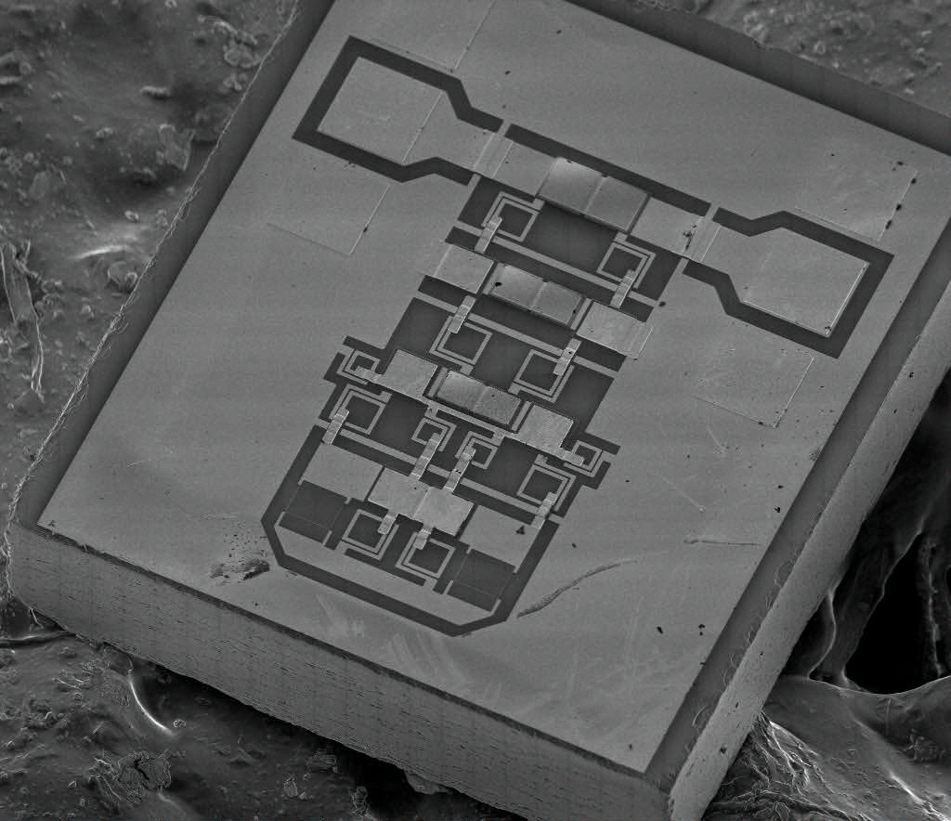
Technical Focus: Reflectionless Filters

Slide 27

What is a Reflectionless Filter?
Stop-Band
Stop-Band
x(t)
y(t)
Pass-Band
Pass-Band

Slide 28
Issues with Conventional Filters
Spurs Recirculate
Standing Waves
Accumulate
Switching
Transients
Rebound
×N
Harmonics
Trapped

Slide 29
Benefits of Reflectionless Filters
Spurs Minimized
Standing Waves
Eliminated
Switching
Transients
Absorbed
×N
Harmonics
Dissipated

Slide 30
A Symmetric Two-Port Network, “N”
Port 1
(Input)
Port 2
(Output)
(symmetry plane)

Slide 31
A Symmetric Two-Port Network, “N”
Identical half-circuits
(wires)

Slide 32
Even-Mode Excitation
+
i = 0
+
X

Slide 33

Even-Mode Excitation
Even-Mode
Equivalent Circuit

Slide 34
Odd-Mode Excitation
+
–
v = 0

Slide 35
Odd-Mode Excitation
Odd-Mode
Equivalent Circuit

Slide 36
Even and Odd-Mode Analysis
Even-Mode
Equivalent Circuit
Odd-Mode
Equivalent Circuit
Γ_{even}
Γ = ½(Γ_{even} + Γ_{odd})
Γ_{odd}
T = ½(Γ_{even} – Γ_{odd})

Slide 37
Even and Odd-Mode Synthesis
Even-Mode
Equivalent Circuit
Odd-Mode
Equivalent Circuit
Γ_{even}
Γ = ½(Γ_{even} + Γ_{odd})
= 0
Γ_{odd}
T = ½(Γ_{even} – Γ_{odd})
= T(f)
Therefore...
Γ_{even} = –Γ_{odd}
Γ_{even} = T(f)
duality
~high-pass transformation

Slide 38
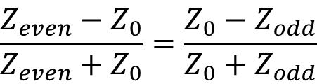


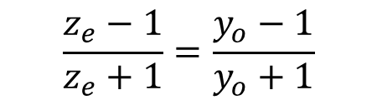
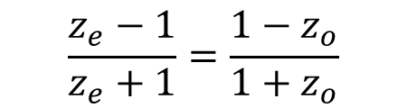
Duality
$$Γ_{even}=−Γ_{odd}$$
$$\frac{Z_{even}−Z_{0}}{Z_{even}+Z_{0}}=\frac{Z_{0}−Z_{odd}}{Z_{0}+Z_{odd}}$$
$$\frac{z_{e}−1}{z_{e}+1}=\frac{1−z_{o}}{{1+z}_{o}}$$
$$\frac{z_{e}−1}{z_{e}+1}=\frac{y_{o}−1}{y_{o}+1}$$
$$z_{e}=y_{o}$$

Slide 39

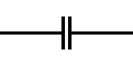

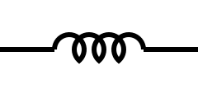
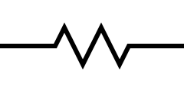
Even and Odd-Mode Synthesis
Even-Mode
Equivalent Circuit
DUAL
Odd-Mode
Equivalent Circuit
Γ_{even}
Γ_{odd}
?
LC High-
Pass Filter

Slide 40

Even and Odd-Mode Synthesis
Even-Mode
Equivalent Circuit
DUAL
Odd-Mode
Equivalent Circuit
Γ_{even}
Γ_{odd}

Slide 41
Even and Odd-Mode Synthesis
Even-Mode
Equivalent Circuit
Odd-Mode
Equivalent Circuit
Γ_{even}
Γ_{odd}

Slide 42
Even and Odd-Mode Synthesis
Even-Mode
Equivalent Circuit
Odd-Mode
Equivalent Circuit
Γ_{even}
Γ_{odd}
?

Slide 43
Even and Odd-Mode Synthesis
Even-Mode
Equivalent Circuit
Odd-Mode
Equivalent Circuit
Γ_{even}
Γ_{odd}

Slide 44

Even and Odd-Mode Synthesis
Even-Mode
Equivalent Circuit
Odd-Mode
Equivalent Circuit
Γ_{even}
Γ_{odd}

Slide 45


Even and Odd-Mode Synthesis
Even-Mode
Equivalent Circuit
Odd-Mode
Equivalent Circuit
Γ_{even}
Γ_{odd}

Slide 46

Even and Odd-Mode Synthesis
Even-Mode
Equivalent Circuit
Odd-Mode
Equivalent Circuit
Γ_{even}
Γ_{odd}

Slide 47
Even and Odd-Mode Synthesis
Even-Mode
Equivalent Circuit
Odd-Mode
Equivalent Circuit
Γ_{even}
Γ_{odd}

Slide 48
Even and Odd-Mode Synthesis
Even-Mode
Equivalent Circuit
Odd-Mode
Equivalent Circuit
Γ_{even}
Γ_{odd}

Slide 49
Even and Odd-Mode Synthesis
Even-Mode
Equivalent Circuit
Odd-Mode
Equivalent Circuit
Γ_{even}
Γ_{odd}

Slide 50

Even and Odd-Mode Synthesis
x
x
x
x
x
x
x
duality
x
symmetry

Slide 51
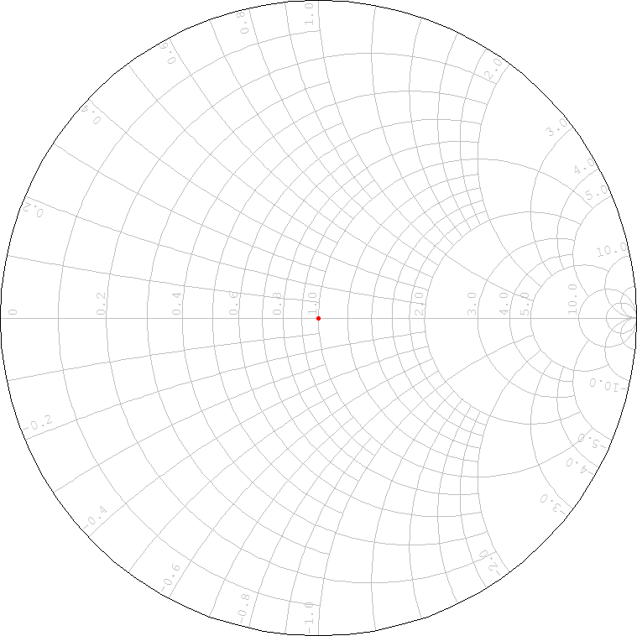
A Third-Order Reflectionless Filter
1
1
1
1
1
1
1
1
s₁₁
1
1
(Element values are normalized
for frequency and impedance.)

Slide 52
Higher-Order Responses Not So Great
1
1
1
1
1
1
1
1
s₁₁
1
1
1
1
1
1
(Element values are normalized
for frequency and impedance.)

Slide 53
Higher-Order Responses Not So Great
1
1
1
1
1
1
1
1
s₁₁
1
1
1
1
1
1
1
1
1
1
(Element values are normalized
for frequency and impedance.)

Slide 54
Subnetwork Expansion

Slide 55

Subnetwork Expansion
a₁
Port 1
Port 2
b₁
H
a₁
b₂
P
P
reflectionless
"Port 3"
"Port 4"
b₃
a₄
termination
termination
H
b₁
a₂
H
P
P
H
a₃
b₄

Slide 56
Subnetwork Expansion
H
a₁
b₂
P
P
A
b₃
a₄
Pt. 3 common Pt. 4
Matched, Two-Port
Subnetwork
H
termination
termination
b₁
a₂
H
P
P
H
a₃
b₄
A

Slide 57
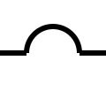
Subnetwork Expansion
Pt. 3 common Pt. 4
Matched, Two-Port
Subnetwork

Slide 58
A Seventh-Order Reflectionless Filter
2x
x = y = z = 1
x
x
x
x
2y
y
2x
y
y
y
s₁₁
2z
z
2y
z
z
z
2z
1
1
(Element values are normalized
for frequency and impedance.)

Slide 59
Element Value Generalization
2/g₁
g₁ = g₂
1/g₂
1/g₂
1/g₂
1/g₂
2/(g₃–g₂)
1/g₄
2/(g₃–g₄)
1/g₄
1/g₄
1/g₄
s₁₁
2/(g₅–g₄)
1/g₆
2/(g₅–g₆)
1/g₆
1/g₆
1/g₆
g₆ = g₇
2/g₇
1
1
(Element values are normalized
for frequency and impedance.)

Slide 60
Topological Generalization
2/g₁
1/g₂
2/(g₁–g₂)
1/g₂
1/g₂
1/g₂
2/(g₃–g₂)
1/g₄
2/(g₃–g₄)
1/g₄
1/g₄
1/g₄
s₁₁
2/(g₅–g₄)
1/g₆
2/(g₅–g₆)
1/g₆
1/g₆
1/g₆
2/(g₇–g₆)
2/g₇
1
1
(Element values are normalized
for frequency and impedance.)

Slide 61
Limiting Ripple Factor
2/g₁
1/g₂
2/(g₁–g₂)
1/g₂
1/g₂
1/g₂
2/(g₃–g₂)
1/g₄
2/(g₃–g₄)
1/g₄
1/g₄
1/g₄
2/(g₅–g₄)
1/g₆
2/(g₅–g₆)
1/g₆
1/g₆
1/g₆
2/(g₇–g₆)
2/g₇
1
1
(Element values are normalized
for frequency and impedance.)

Slide 62
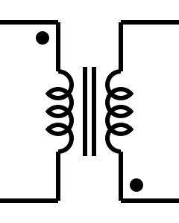

Negative Element Mitigation
2/g₁
1/g₂
2/(g₁–g₂)
1/g₂
1/g₂
1/g₂
2/(g₃–g₂)
1/g₄
2/(g₃–g₄)
1/g₄
1/g₄
1/g₄
2/(g₅–g₄)
1/g₆
2/(g₅–g₆)
1/g₆
–
+
1/g₆
1/g₆
+
+
=
+
+
2/(g₇–g₆)
2/g₇
1
1
(Element values are normalized
for frequency and impedance.)

Slide 63
Negative Element Mitigation
2/g₁
1/g₂
2/(g₁–g₂)
1/g₂
The rest of the filter...
1/g₂
1/g₂
2/(g₃–g₂)
1/g₄
2/(g₃–g₄)
1/g₄
1/g₄
1/g₄
2/(g₅–g₄)
1/g₆
2/(g₅–g₆)
1/g₆
1/g₇
2/g₇
1/g₇
2/(g₆–g₇)
1:1
1
1
(Element values are normalized
for frequency and impedance.)

Slide 64
Negative Element Mitigation
2/g₁
1/g₂
2/(g₁–g₂)
1/g₂
The rest of the filter...
(Element values are normalized
for frequency and impedance.)

Slide 65
Negative Element Mitigation
2/g₁
1/g₂
2/(g₁–g₂)
1/g₂
i_{a}
i_{a}+i_{b}
i_{b}
The rest of the filter...
(Element values are normalized
for frequency and impedance.)

Slide 66
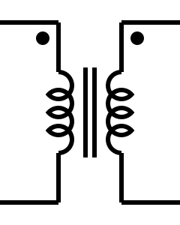
Negative Element Mitigation
2/g₁
1/g₂
2/(g₁–g₂)
1/g₂
i_{a}
i_{a}
i_{b}
i_{b}
The rest of the filter...
(Element values are normalized
for frequency and impedance.)

Slide 67
Negative Element Mitigation
2/g₁
+
+
+
+
1/g₂
2/(g₁–g₂)
1/g₂
–
=
+
The rest of the filter...
(Element values are normalized
for frequency and impedance.)

Slide 68


Negative Element Mitigation
2/g₁
1/g₁
1/g₁
1:1
2/(g₂–g₁)
2/(g₂–g₁)
A little redundant...
1/g₂
1/g₂
2/(g₃–g₂)
1/g₄
2/(g₃–g₄)
1/g₄
1/g₄
1/g₄
2/(g₅–g₄)
1/g₆
2/(g₅–g₆)
1/g₆
1/g₇
2/g₇
1/g₇
2/(g₆–g₇)
1:1
1
1

Slide 69
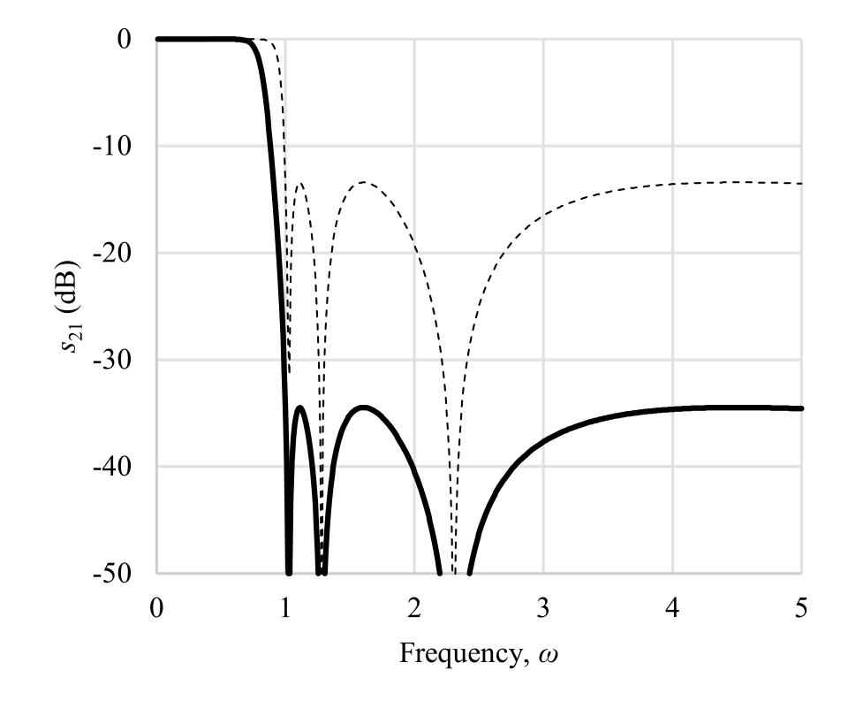
No More Negative Elements!
2/g₁
1/g₁
1/g₁
1:1
2/(g₂–g₁)
s₁₁
1/g₂
1/g₂
2/(g₃–g₂)
1/g₄
2/(g₃–g₄)
1/g₄
1/g₄
1/g₄
2/(g₅–g₄)
1/g₆
2/(g₅–g₆)
1/g₆
1/g₇
2/g₇
1/g₇
2/(g₆–g₇)
1:1
1
1

Slide 70
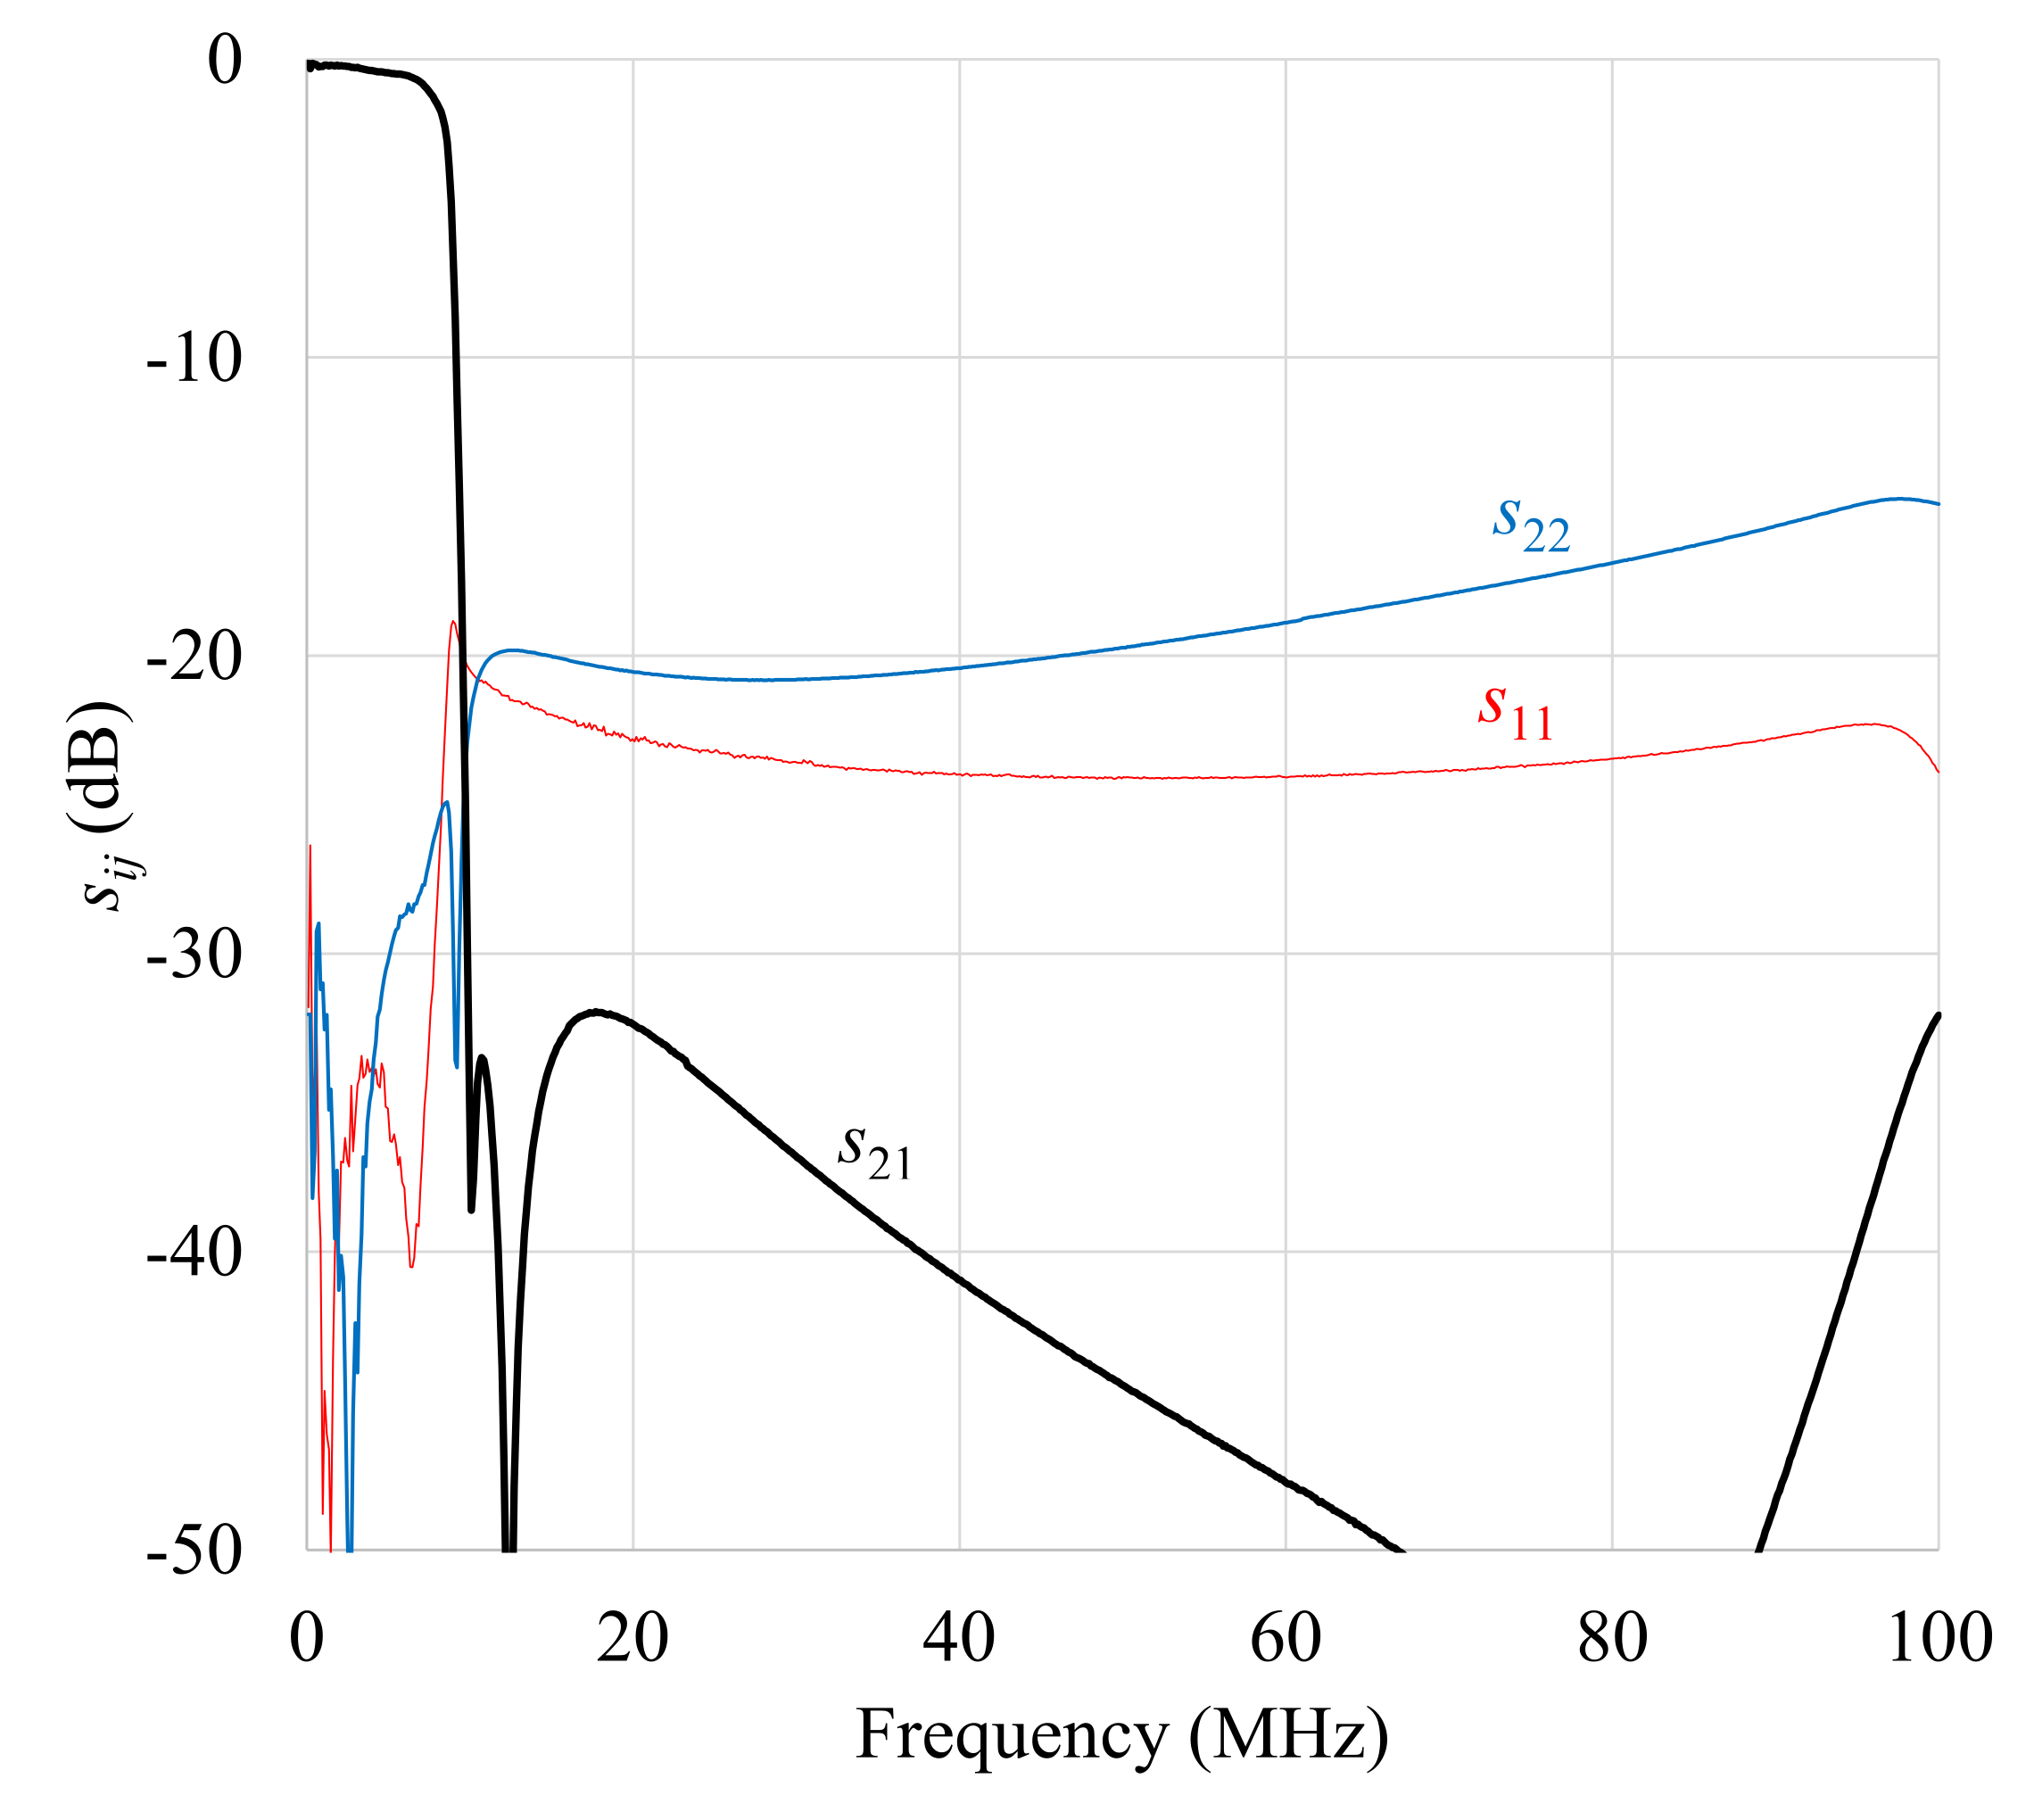
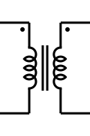
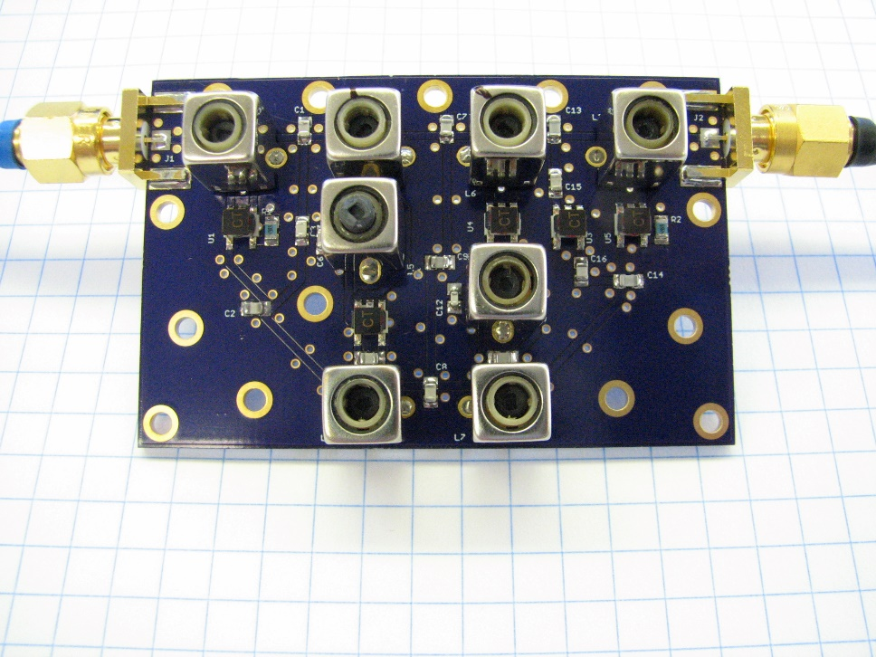
Elliptic Filters
L₃
L₆
C₁₃
L₁
C₄
C₁₀
L₂
C₁
C₇
1:1
C₁₅
L₅
C₆
1:1
1:1
C₃
C₉
1:1
L₈
C₁₂
C₂
1:1
C₈
C₁₆
C₅
C₁₁
R₁
C₁₄
R₂
L₄
L₇
A. Guilabert, M. Morgan, and T. Boyd, “Reflectionless filters for generalized elliptic transmission functions,” IEEE Transactions on Circuits and Systems I, vol. 66, no. 12, pp. 4606-4618, December 2019.

Slide 71
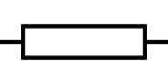
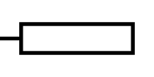
Transmission-Line Solutions As Well...
z_{e} = √ρ, z_{o} = 1/√ρ
(x–x^{–1}) ^{–1}
(x–x^{–1}) ^{–1}
1
1
x–x^{–1}
x–x^{–1}
ρ = (x+√(x²–1))²
s₁₁
z_{e} = 2ρ/(ρ +1), z_{o} = 2/(ρ +1)
(x–x^{–1}) ^{–1}
x
x
(x–x^{–1}) ^{–1}
1
1
x–x^{–1}
x–x^{–1}
ρ = 1+2(x–x^{–1})+2 √((x–x^{–1})(1+x–x^{–1}))

Slide 72
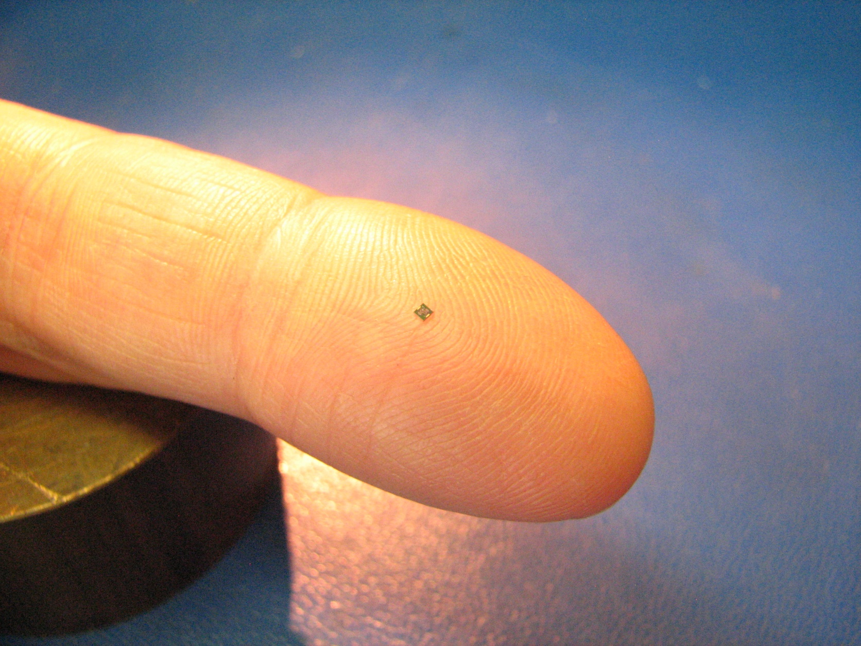
Planar Die Implementation

Slide 73
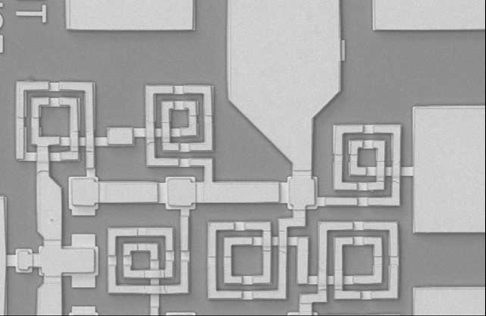
Planar Die Implementation

Slide 74
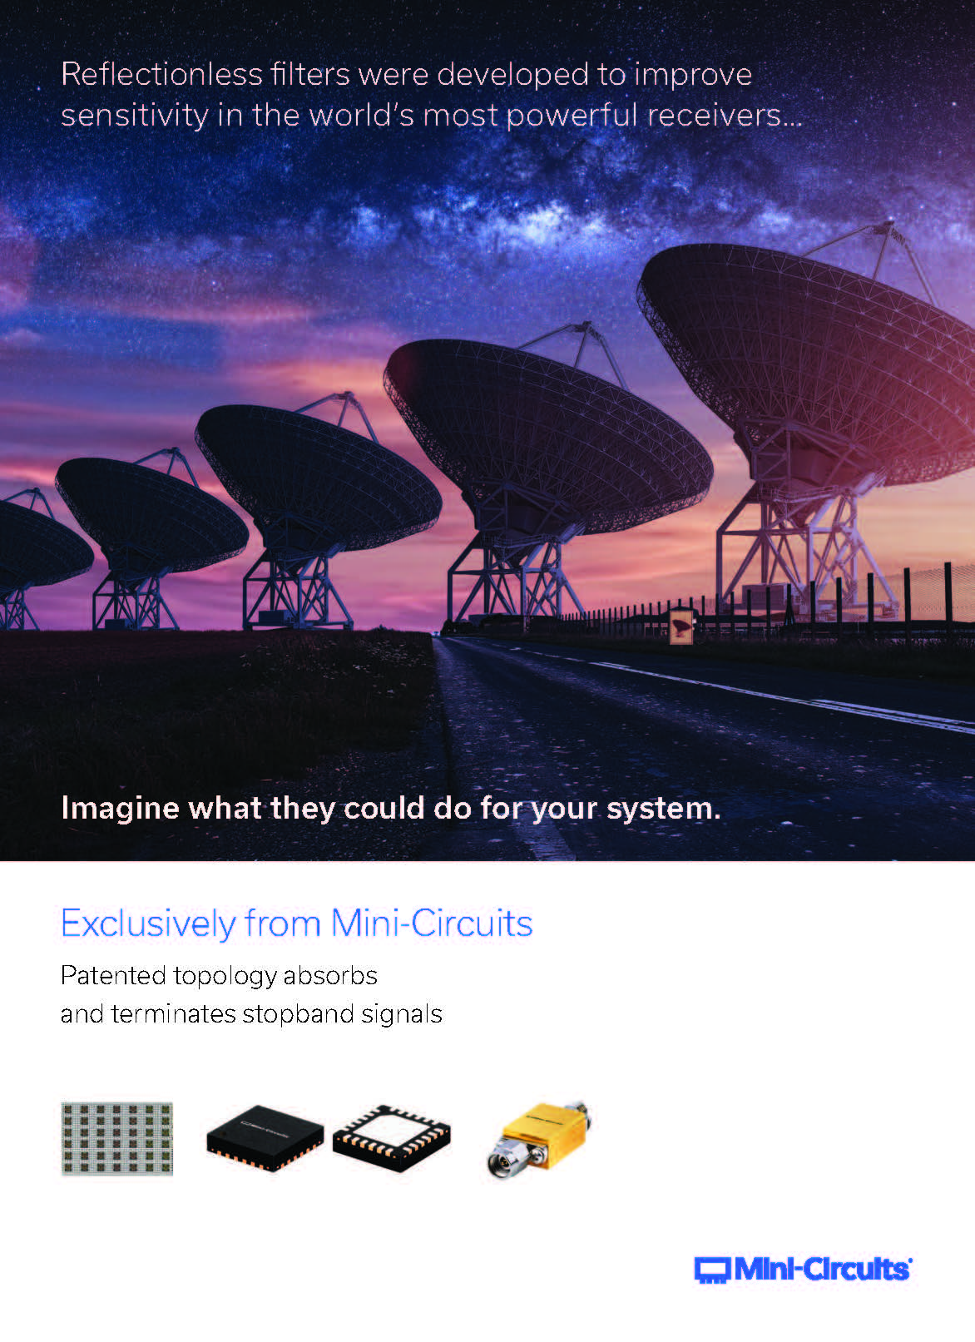


Now Marketed by Mini-Circuits

Slide 75
Adopted by Industry
Nearly 900 technology companies now taking advantage of reflectionless filters, including:
Key Application Areas:
Test and Measurement
VNAs
Signal sources
Spectrum analyzers
Telecommunications
Not in handsets themselves, but in handset verification systems
Base station hardware
Defense
ANRITSU
NOKIA
TERADYNE
KEYSIGHT
ROCKWELL
NORTHROP GRUMMAN
COBHAM
ANALOG DEVICES
SPACE EXPLORATION TECHNOLOGIES
BAE
RAYTHEON
ROHDE & SCHWARZ
NATIONAL INSTRUMENTS
ADVANTEST
LOCKHEED-MARTIN
MERCURY SYSTEMS
APPLE COMPUTER
TEKTRONIX INC
VIASAT
QUALCOMM
MITSUBISHI
L3 HARRIS

Slide 76


References
Books and Book Chapters
M. Morgan, Reflectionless Filters, Norwood, MA: Artech House, January 2017.
M. Morgan, “Reflectionless filter topologies,” Wiley Encyclopedia of Electrical and Electronics Engineering, pp. 1-13, August 2019.
M. Morgan, “Planar reflectionless filters.” In J. Hong, ed., Advances in Planar Filters Design, London: SciTech Publishing, 2019.
Academic Papers and Magazine Articles
A. Guilabert, M. Morgan, and T. Boyd, “Reflectionless filters for generalized elliptic transmission functions,” IEEE Transactions on Circuits and Systems I, vol. 66, no. 12, pp. 4606-4618, December 2019.
R. Shrotriya and M. Morgan, “Filtering without reflections: flattening multiplier chain conversion efficiency & more,” Microwave Journal White Paper, September 2019.
M. Morgan, W. Groves, and T. Boyd, “Reflectionless filter topologies supporting arbitrary low-pass ladder prototypes,” IEEE Transactions on Circuits and Systems I, vol. 66, no. 2, pp. 594-604, February 2019.
M. Morgan, “Think outside the band: design and miniaturization of absorptive filters,” IEEE Microwave Magazine, vol. 19, no. 7, pp. 54-62, November 2018.
M. Morgan, “A better way to filter -- part I,” NRAO Blog, March 29, 2018.
R. Setty, B. Kaplan, M. Morgan, and T. Boyd, “Combining MMIC reflectionless filters to create UWB bandpass filters,” Microwave Journal, vol. 61, no. 3, pp. 60-72, March 2018.
M. Morgan and T. Boyd, “Reflectionless filter structures,” IEEE Trans. Microw. Theory Techn., vol. 63, no. 4, pp. 1263-1271, April 2015.
M. Morgan and T. Boyd, “Theoretical and experimental study of a new class of reflectionless filter,” IEEE Trans. Microwave Theory Tech., vol. 59, no. 5, pp. 1214-1221, May 2011.
Application Notes
“Advantages of cascading reflectionless filters,” Mini-Circuits Application Note, AN75-008.
“Pairing mixers with reflectionless filters to improve system performance,” Mini-Circuits Application Note, AN75-007.
Patents
M. Morgan, “Deep rejection reflectionless filters,” U.S. Patent No. 10,530,321, January 7, 2020, Taiwan Patent No. I699970B, July 21, 2021.
M. Morgan, “Sub-network enhanced reflectionless filter topology,” U.S. Patent No. 9,705,467, July 11, 2017, No. 10,230,348, March 12, 2019, Taiwan Patent No. I581494B, May 1, 2017, People’s Republic of China Patent No. 107078708B, February 9, 2021.
M. Morgan, “Optimal response reflectionless filter topologies,” U.S. Patent No. 10,516,378, December 24, 2019.
M. Morgan, “Optimal response reflectionless filters,” U.S. Patent No. 10,374,577, August 6, 2019, No. 10,263,592, April 16, 2019. Taiwan Patent No. I653826B, March 11, 2019.
M. Morgan, “Transmission line reflectionless filters,” U.S. Patent No. 9,923,540, March 20, 2018, No. 10,277,189, April 30, 2019, Japan Patent No. 6652970B2, January 28, 2020, 6964152B2, October 20, 2021.
M. Morgan, “Reflectionless filters,” U.S. Patent No. 8,392,495, March 5, 2013. People's Republic of China Patent No.102365784B, July 30, 2014.

Slide 77

Thank You!

